Slide 1

British Airways Review Analysis
Task 1

Slide 2
Key Points
Overall Sentiment:
The reviews show a mix of sentiments. While there is a significant amount of positive feedback, there are also notable negative and neutral reviews.
Positive reviews often highlight excellent service and friendly staff.
Negative reviews frequently mention issues with punctuality, customer service, and baggage handling.
Common Themes:
Service Quality: Many reviews discuss the quality of in-flight service, with mixed opinions on meal quality, comfort of seats, and entertainment options.
Staff Behavior: The attitude and helpfulness of the airline staff are recurring themes, with both praise for courteous staff and criticism for unprofessional behavior.
In-Flight Experience: Passengers comment on the overall experience, including cleanliness of the aircraft, ease of boarding, and the ambiance of the cabin.

Slide 3
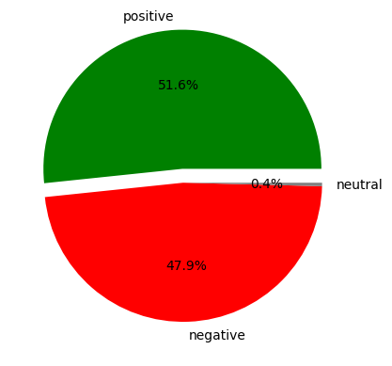
Sentiment Distribution Pie Chart
This pie chart illustrates the proportion of positive, negative, and neutral sentiments extracted from the reviews.
Positive reviews constitute a significant portion, but negative and neutral reviews are also present, indicating room for improvement.

Slide 4
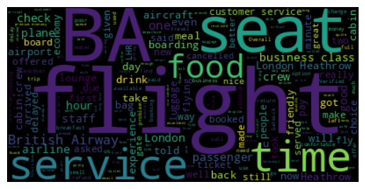
Word Cloud
The word cloud highlights the most frequently mentioned words in the reviews.
Words like "service," "staff," "flight," "experience," and "quality" are prominent, suggesting these are key areas of focus for passengers.

Slide 5
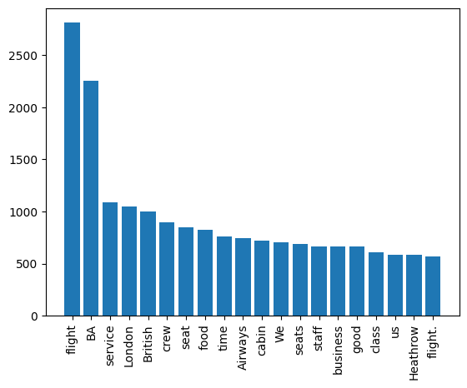
Frequency Chart
This bar chart shows the top 20 most frequently used words in the reviews.
It provides insight into what passengers are talking about the most, helping to identify key issues and areas of excellence.
Common words include "service," "staff," "good," "flight," "time," "seat," "experience," and "food."

Slide 6
Detailed Insights
Positive Sentiment:
Customers appreciate the professionalism and friendliness of the cabin crew.
Positive mentions of in-flight entertainment and food quality, particularly in premium classes.
Good experiences with online booking and check-in processes.
Negative Sentiment:
Complaints about delays and flight cancellations without adequate compensation or communication.
Issues with lost or delayed baggage.
Reports of unresponsive or rude customer service, both in-flight and at airports.
Discomfort due to cramped seating, especially in economy class.
Neutral Sentiment:
Mixed reviews often highlight a balance of good and bad experiences, such as good service overshadowed by delays or vice versa.
These reviews indicate variability in service quality across different flights and routes.

